Slide 1
Robot Project Meeting – 25/10/2018
Bourgogne, Colrat, Evaux, Gaizi, Nicolle – ACE TEAM

Slide 2
Last Meeting:
The following are the points we discussed:
Using the project management tool in Excel
The general progress of the project with demonstration of the progress on the camera and Bluetooth communication
To be done:
@Amine Forward the Project Management Tools to the other students - Done
@Abdoul & Amine: set a meeting to understand how to use the Project Management Tool - Not needed

Slide 3
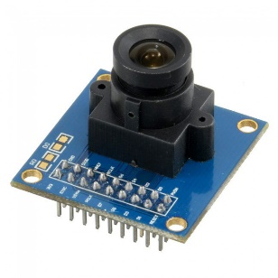
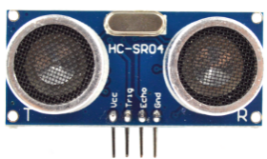
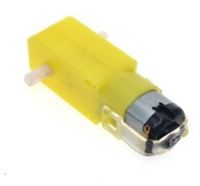
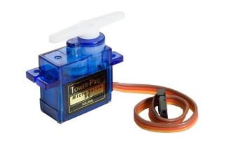
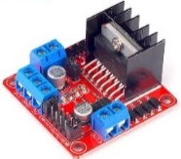

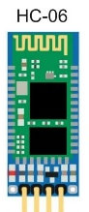

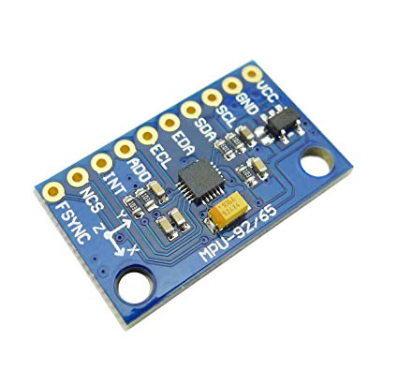
Block Diagrams: Robot Project
Ultrasonic
Data
Servomotor
Camera
Motors
PWM
Data
Aurix Master
TC297B-Step
Aurix for Camera
TC297B-Step
PWM
Uart
Servomotor
Uart
I2C
Uart
Ethernet
PC command
Raspberry Pi 3B+
Gyroscope
Mecanical link
Wireless Bluetooth communication

Slide 4
Block Diagrams: Aurix TC297-B
Movement
Equipment: 2 Motors, 2 Encoders, H-Bridge
Aurix Modules: GPO, GTM TOM, ERU
Control the robot‘s movements in all 4 direction with variable speed
Bluetooth
Equipment: Module Bluetooth HC-05
Aurix Modules: ASC(LIN)
Adds wireless communication capabilities to the robot through Bluetooth
Ultrasonic detection
Equipment: ultrasonic sensor HC-SR04
Aurix Modules:ERU, GPIO, STM
Detects the presence of obstacle, and measure distance to the nearest one
Camera
Equipment: camera OV7670, Raspberry Pi 3B+, 2x HC-06
Aurix Interfaces: CIF, Ethernet
Detect Numbers (from 1 to 5)

Slide 5
Block Diagrams: Aurix TC297-B
Servomotors
Equipment: 2 Servomotors
Aurix Modules: GPIO, GTM TOM, STM
Control the servomotors movement and position
Orientation and Acceleration
Equipment: MPU-92/65,3 Axis angular, 3 Axis accelerometer
Aurix Modules: I2C
Collect inforamtions on the angaular position and acceleration

Slide 6
Amine: Movements Block Diagrams
*H-Bridge Pin Assignment for going forward, to go backward invert In1 with In2 and In3 with In4
Aurix TC297-B Step
Encoder Output
External Request Unit
Encoder Output
Port 15 pin 5
Port 10 pin 7
Collects information
From Motors
Mesures distance and stops
Collects information
From Motors
PWM signal
GTM Timer Output Module
PWM signal
Port 33 pin 6
Port 00 pin 12
General Purpose Outputs
Triggers
H-Bridge*
EnB
In4
In2
EnA
P33.4
P33.2
P00.4
P00.6
In1
In3
Motor
Out B
Out A
Motor
Supplies Robot Motors in current

Slide 7

Marlon: Ultrasonic Sensor Block Diagrams
TC29TF
Ultrasonic Sensor
HC-SR04
8 impulses
CPU ctrl
P14.4
High signal for >= 10 µs
sendTrig()
Trig
G
P
I
O
P14.4
returnDistance()
External interrupt input
Obstacle
Echo
echo
P20.9
isrGetDistance()
ACRONYM:
ERU: External Request Unit
GPIO: General Purpose Input Output
FUNCTION OVERVIEW:
sendTrig() : send trigger to ultrasonic sensor to start obstacle detection
returnDistance(): check distance value for abnormal value and return it
isrGetDistance(): interrupt routine to get distance from Echo signal
ERU
P20.9

Slide 8
Virgile: Bluetooth communication
TC29TF
Bluetooth module
HC-05
Application
ASCLIN
rx
rx
serial_send()
P15.3
serialRxISR()
tx
tx
P15.2
commands
Responses & updates
(if requested)
Bluetooth capable device
serial_send(uint8 message):sends responses to command messages (if requested)
serialRxISR(): receives command message in interrupt mode.

Slide 9
Maxime: Block Diagrams - Camera
Camera OV7670
CIF
interface
Aurix TC297-Bstep
Eth
Rasberry Pi 3B+
Aurix TC297-Bstep
(master)
Bluetooth
Established if :
Number is detected

Slide 10
Subtasks: Amine Wheel enslavment
Done:
Acceleration and deceleration functions working
Proportional correction working and Integrate correction implemented but not yet calibrated properly
To Do:
Calibrate Integrate correction, Derivative correction probably not needed
Write Documentation, and add the enslavement code on the master project on Github
Start working on a more precise correction when the gyroscope will be implemented
Sensor fusion with Encoders and Gyroscope ?
Deadline: Mid November

Slide 11
Subtasks: Marlon - Servomotors
Done:
Sweep function to allow sweeping motion from servo
Move function to hold servo in a certain position
To do:
Comment code
Write the wiki page
Sort out issue with current draw when 2 servos are used

Slide 12
Marlon: Servomotors Block Diagrams
TC29TF
CPU_ctrl
P33.10
config_servomotor()
GPIO
PWM3
P33.5
Servomotor_1
sweep_servo()
GTM TOM
PWM4
Servomotor_2
move_servo(duty_position)
timer_compare_config()
STM
STM_INTERRUPT()

Slide 13
Subtasks: Virgile, Bluetooth communication
Done:
Finish the code for the Bluetooth module used in interrupt mode
To do:
Implement and test the Bluetooth capabilities in the final code
Finish writing the wiki page
Deadline: End of October

Slide 14
Substaks: Maxime, Camera
Done
None
To Do
Send video to a GUI (first step) and after to the Raspberry by ethernet (I asked Rahul to help me)
Take minimum 2500 pictures to pre-train our own CNN
Bluetooth communication (Rasberry <-> Aurix Master)
Documentation on Wiki page (in progress)
Deadline: Mid/End of November

Slide 15
Subtasks: Guillaume, gyroscope
Done:
To do:
Read the code demo for I2C
Integrate the code into Amine movement program
Wiki
Look at the possible noise which appears when the mpu92/65 gets the info

Slide 16
Guillaume: Blocks Diagram - Gyroscope
3,3V
MPU-92/65
Aurix Master
Gyroscope
VDD
I2C
I2C
CPU
SDA
Data Treatment
Accelerometer
SCL
Amine‘s movement program
Magnetometer
AD0

Slide 17
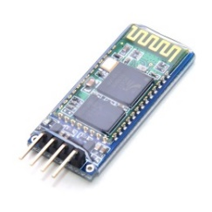
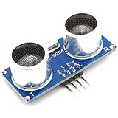
As a reminder – in the 1st meeting
First Step:
Movements: PWM & encoders configuration is working
Adjust Speed, direction, encoders data processing Amine
Communication: Board with Bluetooth Module Virgile
Send instructions to the Board that should understand them
Ultra Sonic Obstacle detection Marlon
Analyze the environment

Slide 18
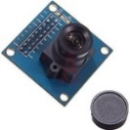
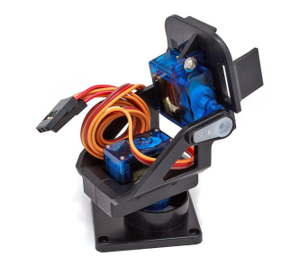
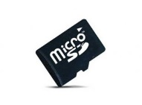
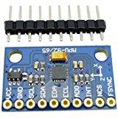
As a reminder – in the 1st meeting
Second Step:
Camera integrated to the robot Maxime
Tough module, takes time to program
Servomotors to change the angle of the camera with PWM
Save pictures in SD Card
Movements enslavement (PID) Amine
Gyroscope: Guillaume
Mapping of the environment’s obstacles with collected data (ultra sonic, camera, gyroscope)

Slide 19
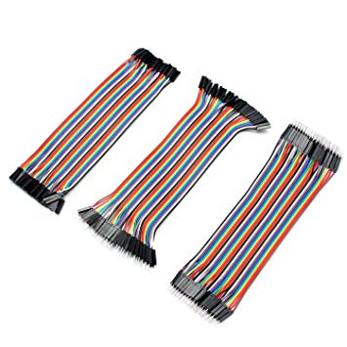
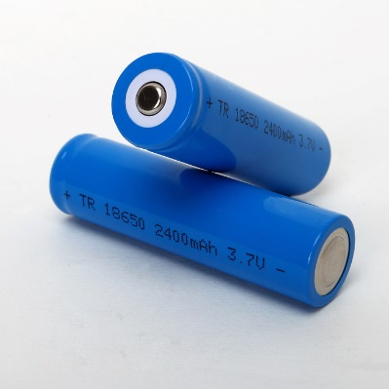
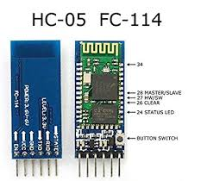
Needed equipment
Dupont cables
3.7 V / 2400 mAh accumulator batteries
HC05 or HC06 Bluetooth modules
Gyroscope MPU-96/65

Slide 20
Conclusion
Soon all the modules will be implemented on the Aurix
We will need to know precisely what the robot should do in what environment to know exactly how to use each module

